Slide 1
Machine Learning Using Support vector Machine(SVM)
Presented by:
Rishab pal
Intern At L&t technology services

Slide 2
What is Machine Learning?
Machine learning is the subfield of computer science that “gives computers the ability to learn without being explicitly programmed”.
Tom M. Mitchell provided a widely quoted, more formal definition: “A computer program is said to learn from experience E with respect to some class of tasks T and performance measure P if its performance at tasks in T, as measured by P, improves with experience E.”

Slide 3
Types of Machine Learning
Supervised Learning
Inferring a function from labelled training data. A supervised learning algorithm analyses the training data (a list of input and their correct output) and produces an appropriate function, which can be used for mapping new examples.
Unsupervised Learning
Inferring a function to describe hidden structure from unlabelled data. No labels are given to the learning algorithm, leaving it on its own to find structure in its input.
Reinforcement Learning
Concerned with how software agents ought to take actions in an environment so as to maximize some notion of cumulative reward.

Slide 4
Types of Supervised Learning
Regression
In a regression problem, we are trying to predict results within a continuous output, meaning that we are trying to map input variables to some continuous function. For example, predicting housing prices where the output is a real number.
Classification
In a classification problem, we are instead trying to predict results in a discrete output. In other words, we are trying to map input variables into discrete categories. For example, predicting whether a particular email is spam or not.
Neural Network
This tool can be used both for regression as well as for classification. It consists of one or more layers of computational units between the input and output for modelling the problem using Back Propagation Algorithm. For complex problems with many features to model, neural network provide efficient solution compared to other techniques.
Support Vector Machine
While Neural Network outputs the probability by which a particular input is close to the output, SVM is a non-probabilistic binary linear classifier. It has the ability to linearly separate the classes by a large margin. Add to it the Kernel and SVM becomes one of the most powerful classifier capable of handling infinite dimensional feature vectors.

Slide 5
Support Vector Machines - What are they?
A Support Vector Machine (SVM) is a supervised machine learning algorithm that can be employed for both classification and regression purposes.
SVMs are more commonly used in classification problems and as such, this is what we will focus on in this post.
SVMs are based on the idea of finding a hyperplane that best divides a dataset into two classes, as shown in the image.
The intuition behind the support vector machine approach is that if a classifier is good at the most challenging comparisons (the points in B and A that are closest to each other in Figure 2), then the classifier will be even better at the easy comparisons (comparing points in B and A that are far away from each other).

Slide 6
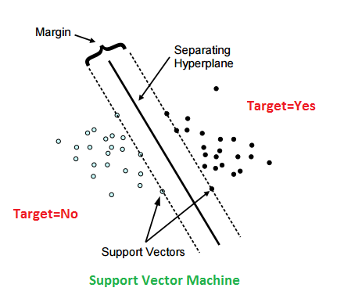
Support Vectors
Support vectors are the data points nearest to the hyperplane, the points of a data set that, if removed, would alter the position of the dividing hyperplane.
Because of this, they can be considered the critical elements of a data set.

Slide 7
What is a hyperplane?
As a simple example, for a classification task with only two features (like the image above), you can think of a hyperplane as a line that linearly separates and classifies a set of data.
Intuitively, the further from the hyperplane our data points lie, the more confident we are that they have been correctly classified. We therefore want our data points to be as far away from the hyperplane as possible, while still being on the correct side of it.
So when new testing data is added, whatever side of the hyperplane it lands will decide the class that we assign to it.

Slide 8
How do we find the right hyperplane? Or, in other words, how do we best segregate the two classes within the data?
The distance between the hyperplane and the nearest data point from either set is known as the margin.
The goal is to choose a hyperplane with the greatest possible margin between the hyperplane and any point within the training set, giving a greater chance of new data being classified correctly.

Slide 9
But what happens when there is no clear hyperplane?
This is where it can get tricky. Data is rarely ever as clean as our simple example above. A dataset will often look more like the jumbled balls below which represent a linearly non separable dataset.
In order to classify a dataset like the one above it’s necessary to move away from a 2D view of the data to a 3D view.
Imagine that our two sets of colored balls above are sitting on a sheet and this sheet is lifted suddenly, launching the balls into the air. While the balls are up in the air, you use the sheet to separate them. This ‘lifting’ of the balls represents the mapping of data into a higher dimension.
Because we are now in three dimensions, our hyperplane can no longer be a line. It must now be a plane as shown in the example above.

Slide 10
How does SVM work ?

Slide 11
Flow diagram for the steps followed during svm classification

Slide 12
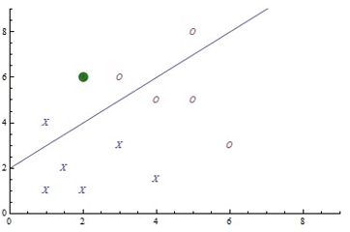
Perceptron CONCEPT
The Perceptron has a number of inputs, combines them and gives a single output.
So for example, it may have 25 inputs which are gray-levels of a 5x5 image and a single output that should, for example, tell whether a cat is in the image or not.
What the Perceptron does now, is to divide the input space into two separate regions.
Now, there are two additions to the Perceptron that make it an SVM:
First the Perceptron has an inherent limitation, it can only find lines. The technical term for this is that Perceptrons can only solve linearly separable problems.
Second, there may be more than one line which separates the data and some lines may be "better" than other lines.

Slide 13
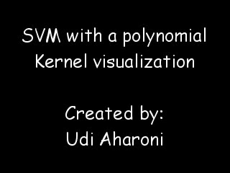
Kernel trick
In SVM the data is not directly projected in a pre-processing step but the projection is part of the SVM.
The evaluation rule of the Perceptron can also be expressed in a dual form: In this form the weight vector is expressed as a sum over dot products between all data points and the input vector.
The crucial point here is that that a dot-product of the input data is used to define the weight vector. Because the dot-product can be replaced by kernel functions, which is the well-known "kernel-trick”.
Kernel functions compute a dot-product in another feature space.
Different kernels have different feature spaces and so choosing a kernel function means choosing a feature space.

Slide 14
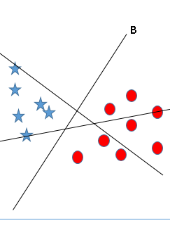
Identify the right hyper-plane (Scenario-1):
Here, we have three hyper-planes (A, B and C). Now, identify the right hyper-plane to classify star and circle.
You need to remember a thumb rule to identify the right hyper-plane: “Select the hyper-plane which segregates the two classes better”. In this scenario, hyper-plane “B” has excellently performed this job.

Slide 15
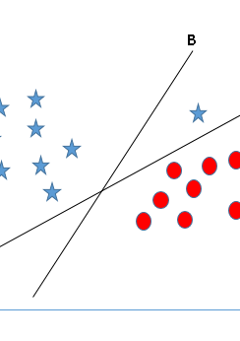
Identify the right hyper-plane (Scenario-2)
SVM selects the hyper-plane which classifies the classes accurately prior to maximizing margin.
Here, hyper-plane B has a classification error and A has classified all correctly.
Therefore, the right hyper-plane is A.

Slide 16
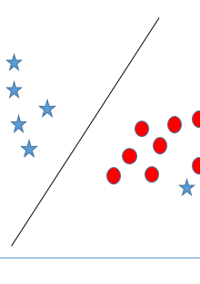
Can we classify two classes (Scenario-3)
Below, I am unable to segregate the two classes using a straight line, as one of star lies in the territory of other(circle) class as an outlier
As I have already mentioned, one star at other end is like an outlier for star class.
SVM has a feature to ignore outliers and find the hyper-plane that has maximum margin. Hence, we can say, SVM is robust to outliers.

Slide 17
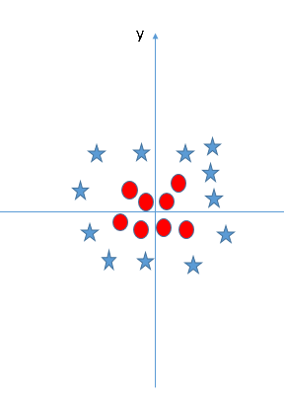
Find the hyper-plane to segregate to classes (Scenario-4):
It solves this problem by introducing additional feature.
Here, we will add a new feature z=x^2+y^2. Now, let’s plot the data points on axis x and z.
This process is most commonly known as Kernel Trick.

Slide 18
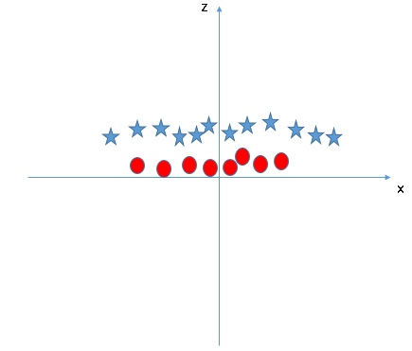
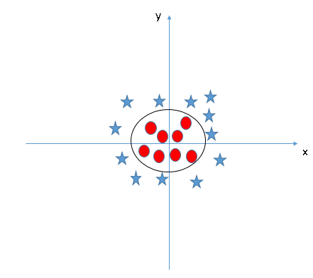
Find the hyper-plane to segregate to classes (Scenario-4):
All values for z would be positive always because z is the squared sum of both x and y
In the original plot, red circles appear close to the origin of x and y axes, leading to lower value of z and star relatively away from the origin result to higher value of z.
When we look at the hyper-plane in original input space it looks like a circle

Slide 19
Comparison of ML algorithms
Naïve Bays | SVM | Maximum Entropy
Easy to Implement | Harder to Implement | Harder to Implement
Less Efficient, Efficient due to working with large sets of Words | Efficiency is maximum | Efficiency is moderate
Limited Use | Versatile Used in Comp Vision, Text Cat, IP | Hardly used

Slide 20
What are the advantages of different classification algorithms?
There are a number of dimensions you can look at to give you a sense of what will be a reasonable algorithm to start with, namely:
Number of training examples
Dimensionality of the feature space
Do I expect the problem to be linearly separable?
Are features independent?
Are features expected to linearly dependent with the target variable?
Is overfitting expected to be a problem?
What are the system's requirement in terms of speed/performance/memory usage?

Slide 21
Disadvantages of some particular algorithms
Instance based learning techniques (e.g. nearest neighbor)
Take up a lot of memory to run (storing all the instances)
Work well for a small number of dimensions, but not a high number of dimensions
Decision trees and divide-and-conquer algorithms
May over fit data
May get stuck in local minima so need ensembles to help reduce the variance
SVM
Picking/finding the right kernel can be a challenge
Results/output are incomprehensible
No standardized way for dealing with multi-class problems; fundamentally a binary classifier
Neural networks
Picking the correct topology is difficult
Training takes a long time/requires a lot of data
Output/issues are incomprehensible

Slide 22
Disadvantages of some particular algorithms continued…
Logistic regression
Limited expressive power
Fundamentally a binary classifier
Hard to make incremental
Naive Bayes
Very simple representation doesn't allow for rich hypotheses
Assumption of independence of attributes is too constraining
Bayes networks/Graphical models
Determining the topology of dependence is difficult

Slide 23
Advantages of some particular algorithms
Naive Bayes:
Super simple, you're just doing a bunch of counts.
If the NB conditional independence assumption actually holds, a Naive Bayes classifier will converge quicker than discriminative models like logistic regression, so you need less training data.
And even if the NB assumption doesn't hold, a NB classifier still often performs surprisingly well in practice.
A good bet if you want to do some kind of semi-supervised learning, or want something embarrassingly simple that performs pretty well.
Logistic Regression:
Lots of ways to regularize your model, and you don't have to worry as much about your features being correlated, like you do in Naive Bayes.
You also have a nice probabilistic interpretation, unlike decision trees or SVMs, and you can easily update your model to take in new data (using an online gradient descent method), again unlike decision trees or SVMs.
Use it if you want a probabilistic framework (e.g., to easily adjust classification thresholds, to say when you're unsure, or to get confidence intervals) or if you expect to receive more training data in the future that you want to be able to quickly incorporate into your model.

Slide 24
Advantages of some particular algorithms Continued…
Decision Trees
Easy to interpret and explain.
Non-parametric, so you don't have to worry about outliers or whether the data is linearly separable (e.g., decision trees easily take care of cases where you have class A at the low end of some feature x, class B in the mid-range of feature x, and A again at the high end).
Their main disadvantage is that they easily overfit, but that's where ensemble methods like random forests (or boosted trees) come in.
Plus, random forests are often the winner for lots of problems in classification (usually slightly ahead of SVMs, I believe), they're fast and scalable, and you don't have to worry about tuning a bunch of parameters like you do with SVMs, so they seem to be quite popular these days.
SVMs:
High accuracy, nice theoretical guarantees regarding overfitting, and with an appropriate kernel they can work well even if you're data isn't linearly separable in the base feature space.
Especially popular in text classification problems where very high-dimensional spaces are the norm.
Memory-intensive and kind of annoying to run and tune, though, so I think random forests are starting to steal the crown.

Slide 25
Random forest vs svm
Almost always have lower classification error and better f-scores than decision trees.
Almost always perform as well as or better than SVMs, but are far easier for humans to understand.
Deal really well with uneven data sets that have missing variables.
Give you a really good idea of which features in your data set are the most important for free.
Generally train faster than SVMs (though this obviously depends on your implementation).

Slide 26
Pros and cons of SVM
Pros:
It works really well with clear margin of separation
It is effective in high dimensional spaces.
It is effective in cases where number of dimensions is greater than the number of samples.
It uses a subset of training points in the decision function (called support vectors), so it is also memory efficient.
Cons:
It doesn’t perform well, when we have large data set because the required training time is higher
It also doesn’t perform very well, when the data set has more noise i.e. target classes are overlapping
SVM doesn’t directly provide probability estimates, these are calculated using an expensive five-fold cross-validation.

Slide 27
Applications of SVM
SVMs are helpful in text and hypertext categorization as their application can significantly reduce the need for labeled training instances in both the standard inductive and transductive settings.
Classification of images can also be performed using SVMs.
Experimental results show that SVMs achieve significantly higher search accuracy than traditional query refinement schemes after just three to four rounds of relevance feedback.
This is also true of image segmentation systems, including those using a modified version SVM that uses the privileged approach as suggested by Vapnik. Hand-written characters can be recognized using SVM.

Slide 28
References
https://machinelearningmastery.com
http://analyticsvidhya.com
https://www.youtube.com/channel/UC8gfDlJagsw5wX2cldDM9Nw
http://wikimediafoundation.org
https://www.youtube.com/user/MIT
https://www.youtube.com/user/stanfordeng
Python for data analysis by Wes McKinney, Oreilly Publication
Python Machine Learning by Sebastian Rasckha, Packtt Publication
Coursera machine learning course by Prof. Andrew Ng

